Slide 1
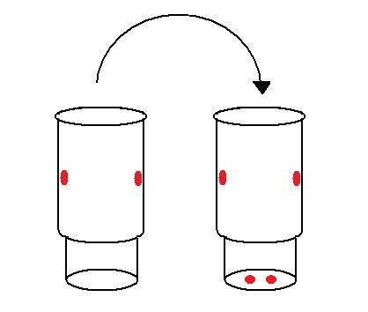
CRP Pitfall Trap Design and Drilling Process
The pitfall trap cup is designed to allow for rainwater drainage. Drilled holes are indicated in red. Cup on left (inner cup) is inserted into cup on right (outer cup). The outer cup remains in the field for 3 years; the inner cup is removed each field season and trap contents are analyzed.
The trap design requires uniformity so that drainage holes align for all cups. Drainage holes must align for drainage.
Use a ¼” drill bit to drill holes in the cups. If you find that another technique is better/faster, please share it with me! 2 sleeves of cups take me about 35 minutes to complete (including re-packaging and clean-up) (~84 cups). With this protocol, it will take about XX hours to drill all pitfall traps for the transects.
22 oz. plastic QT cup with lid (9 cm diameter opening X 15 cm depth)
Inner cup.
This cup is removed and contents are analyzed. It is replaced the following May/June for another collection period.
Outer cup.
This cup is remains in the ground and prevents the hole from collapsing.
Notes:
Dungers
8 x
CRP
18x108=1944 cups = pitfall trap
9x108 = 972 cups needed when retrieving pitfalls

Slide 2
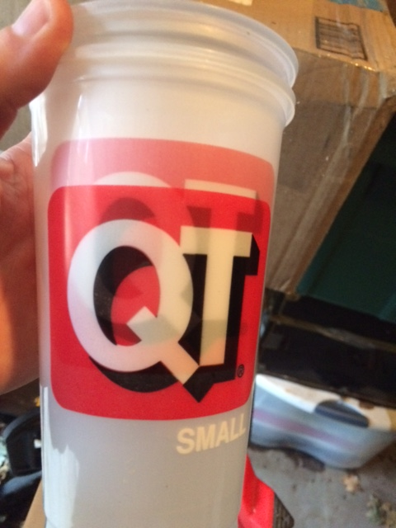
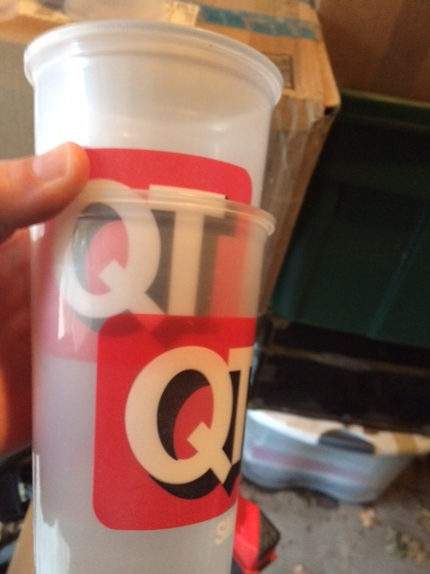
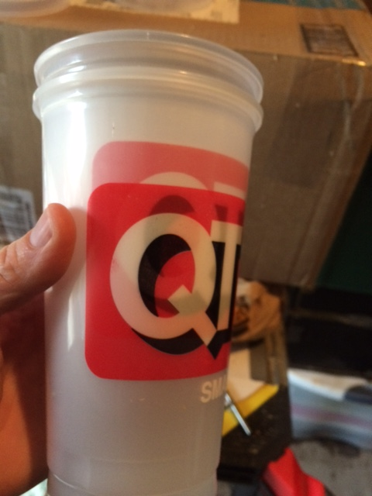
Step 1. Divide a sleeve of cups in half. Drill a ¼” hole in the bottom of the cups. This cup will be the outer cup.
Step 3. …note alignment on one side of the cup…
Step 2. Place a new cup (the inner cup) inside the outer cup. Align the QT labels on the front and the back side of the both cups…
Step 4. … and the other side of the cup. Not all cups align perfectly.

Slide 3
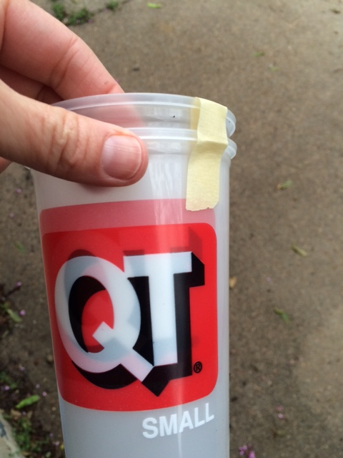
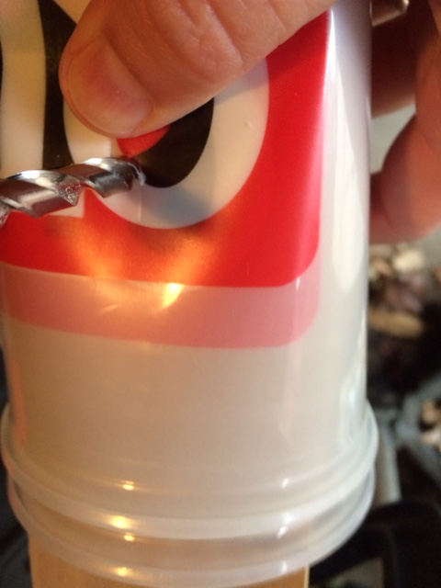
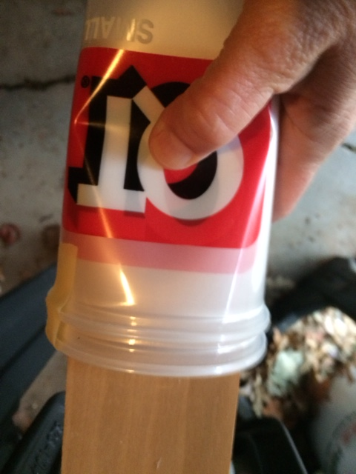
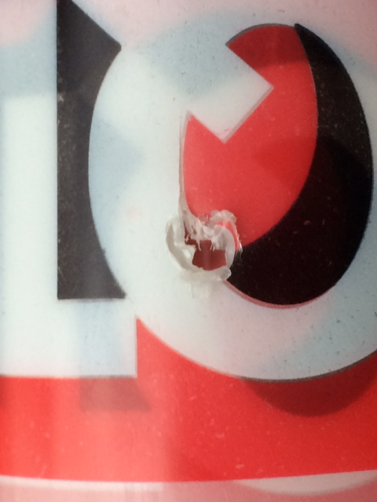
Step 5. Once aligned, join the cups with a piece of masking tape. This keeps the cups aligned while drilling.
Step 7. Drill in the same location in all cups with a ¼” drill bit.
Step 6. Place the aligned cups on a board and compress both together. The white circle is the location to be drilled on each set of cups.
Step 8. There may be remaining plastic bits in the hole, but the cups will still drain. The cup may split slightly at the drill location, but this will still be OK.

